Slide 1
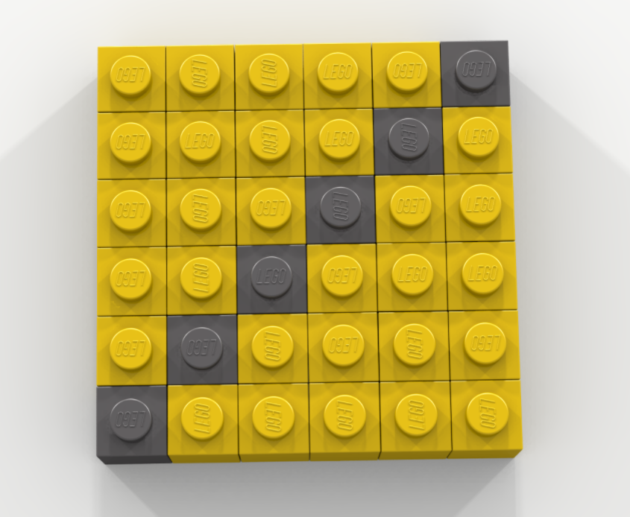
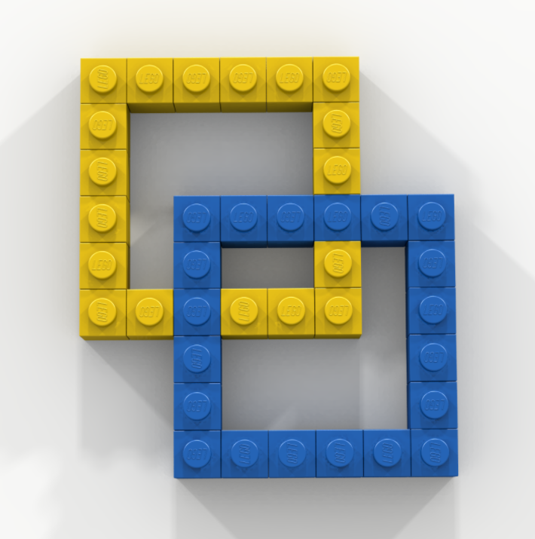
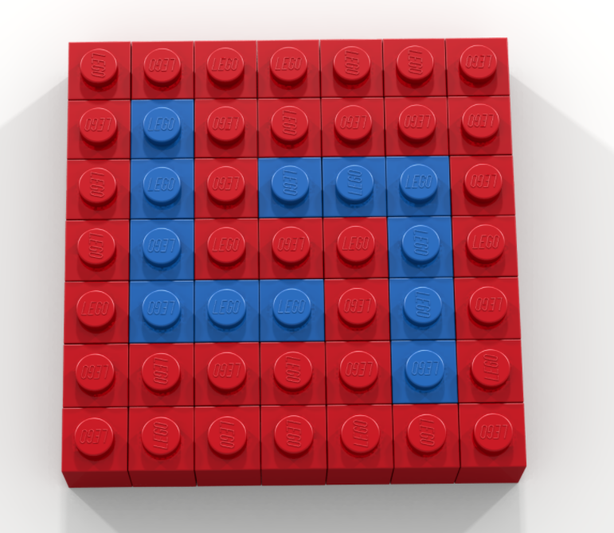
Bell Work: Create the Following 3 Objects in the same Bricklayer-Lite Grid

Slide 2
Math analysis
Day 9

Slide 3
Objective
Finish the image from last class.
Use Bricklayer-Lite to code objects from around the building
Practice our naming conventions

Slide 4
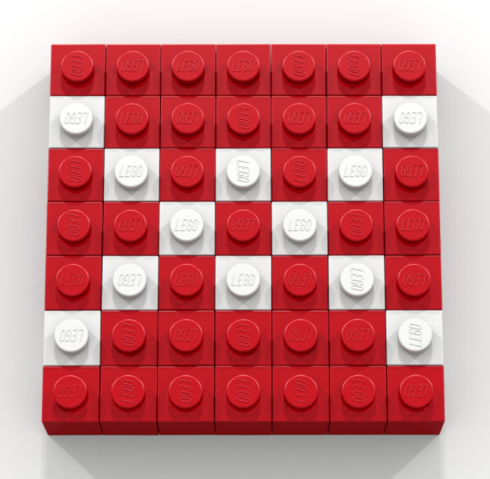
From last time…

Slide 5
Bricklayer-Lite
Using Bricklayer-Lite code, recreate the following objects
Save your code, and upload them into the appropriate folder:
5_Objects Around Bryan In The Grid

Slide 6
How to name our files for saving
Name_object-coded.xml
For example:
Cuddy_yellow-square-gray-diagonal.xml

Slide 7
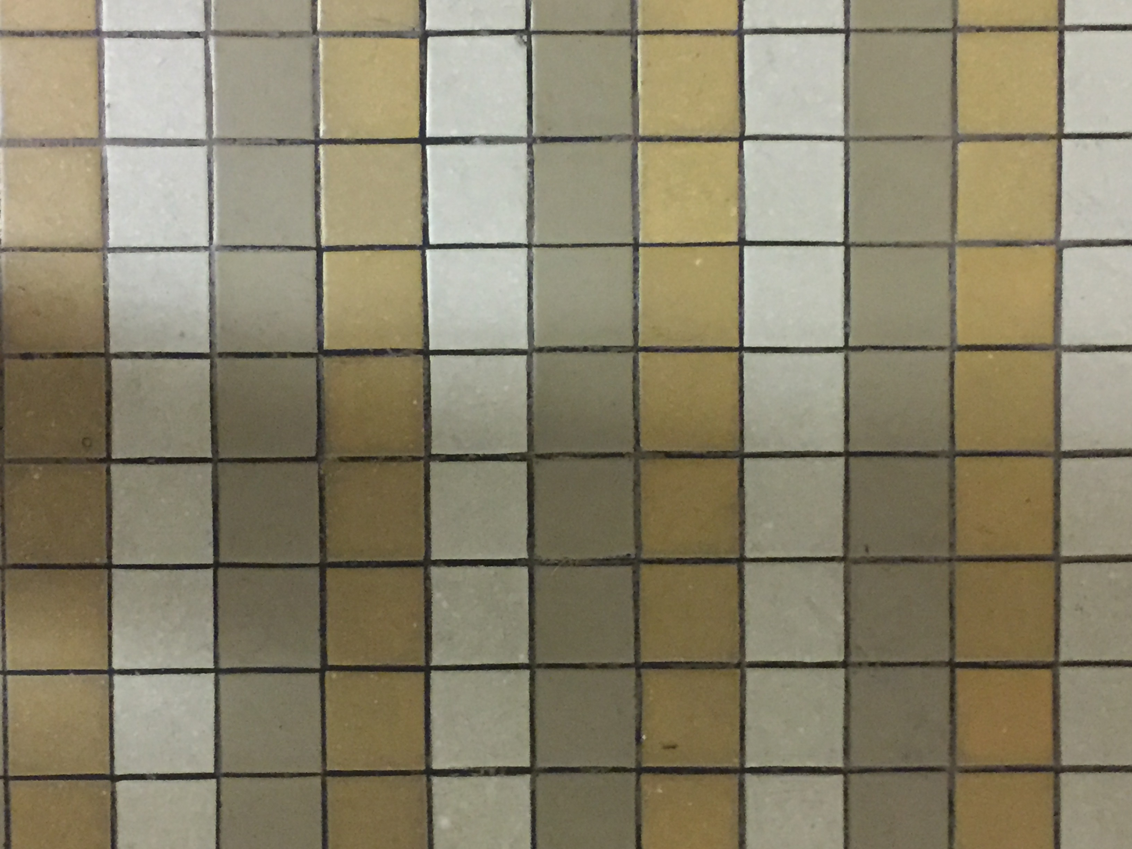
Where have you seen this pattern? Code it in The Grid.

Slide 8
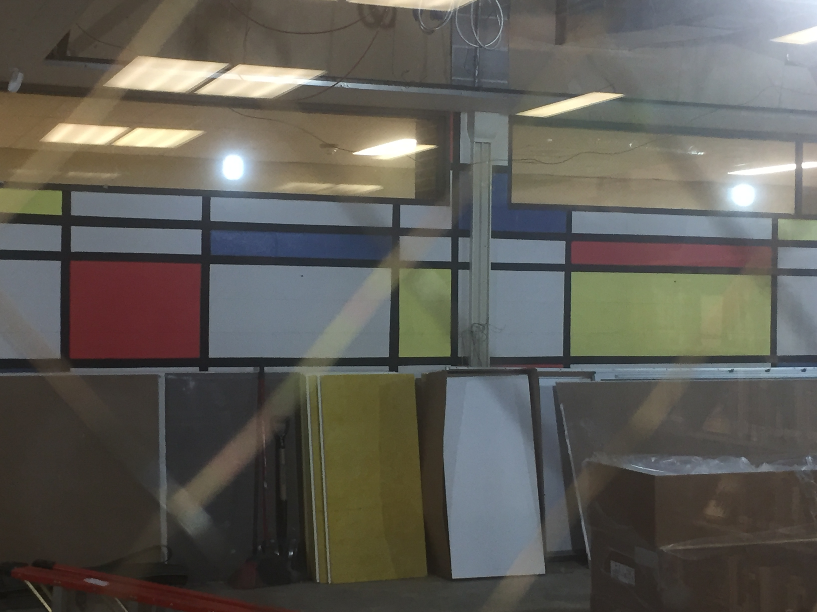
Where have you seen this pattern? Code it in The Grid.

Slide 9
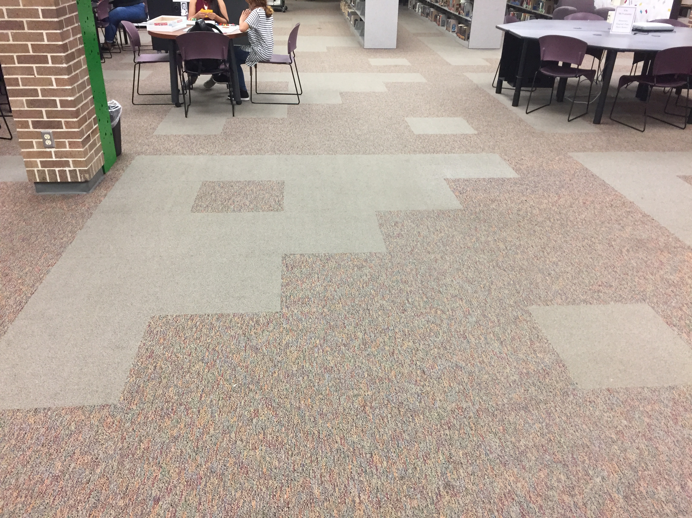
Where have you seen this pattern? Code it in The Grid.

Slide 10
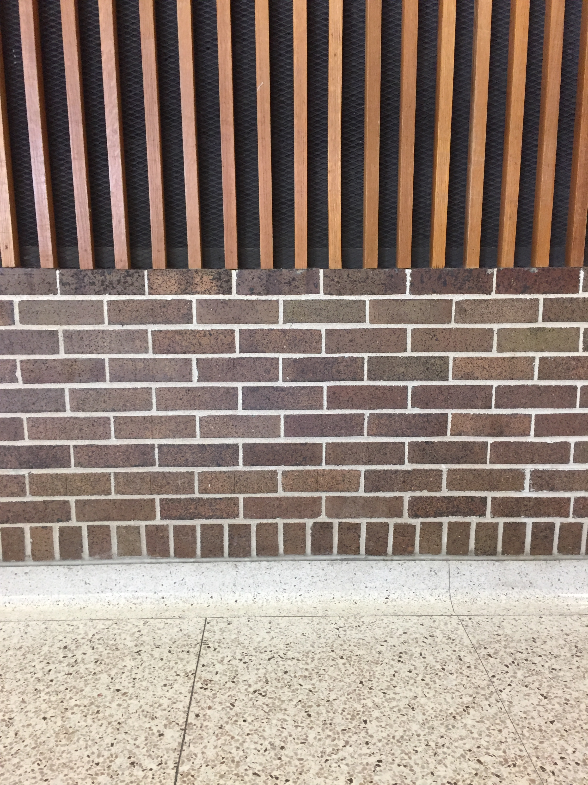
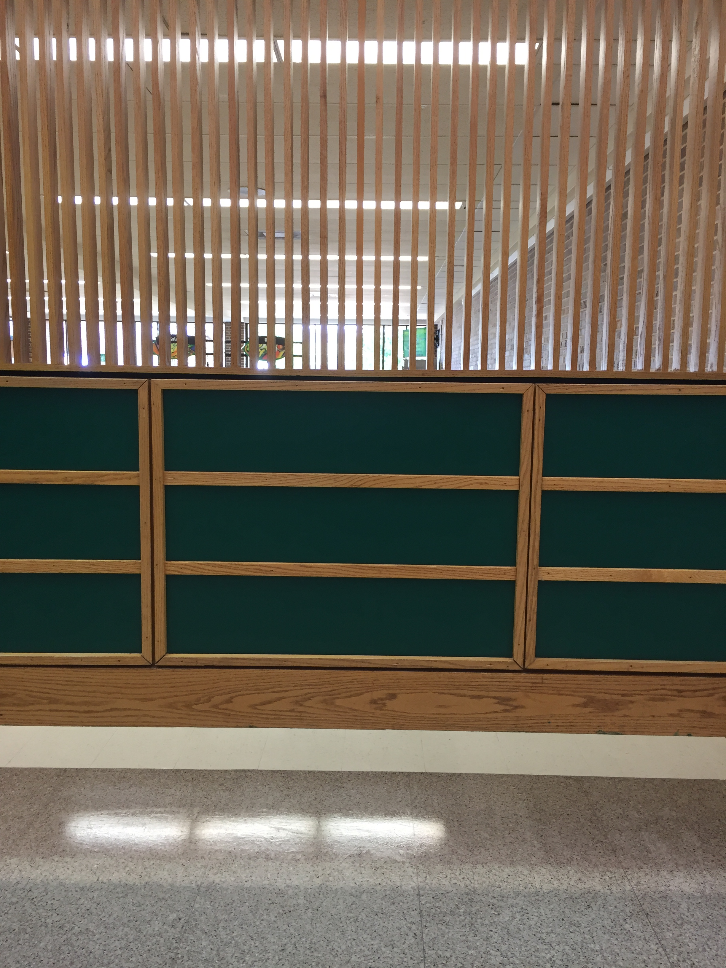
Where have you seen this pattern? (just pick 1 to code in The Grid)

Slide 11
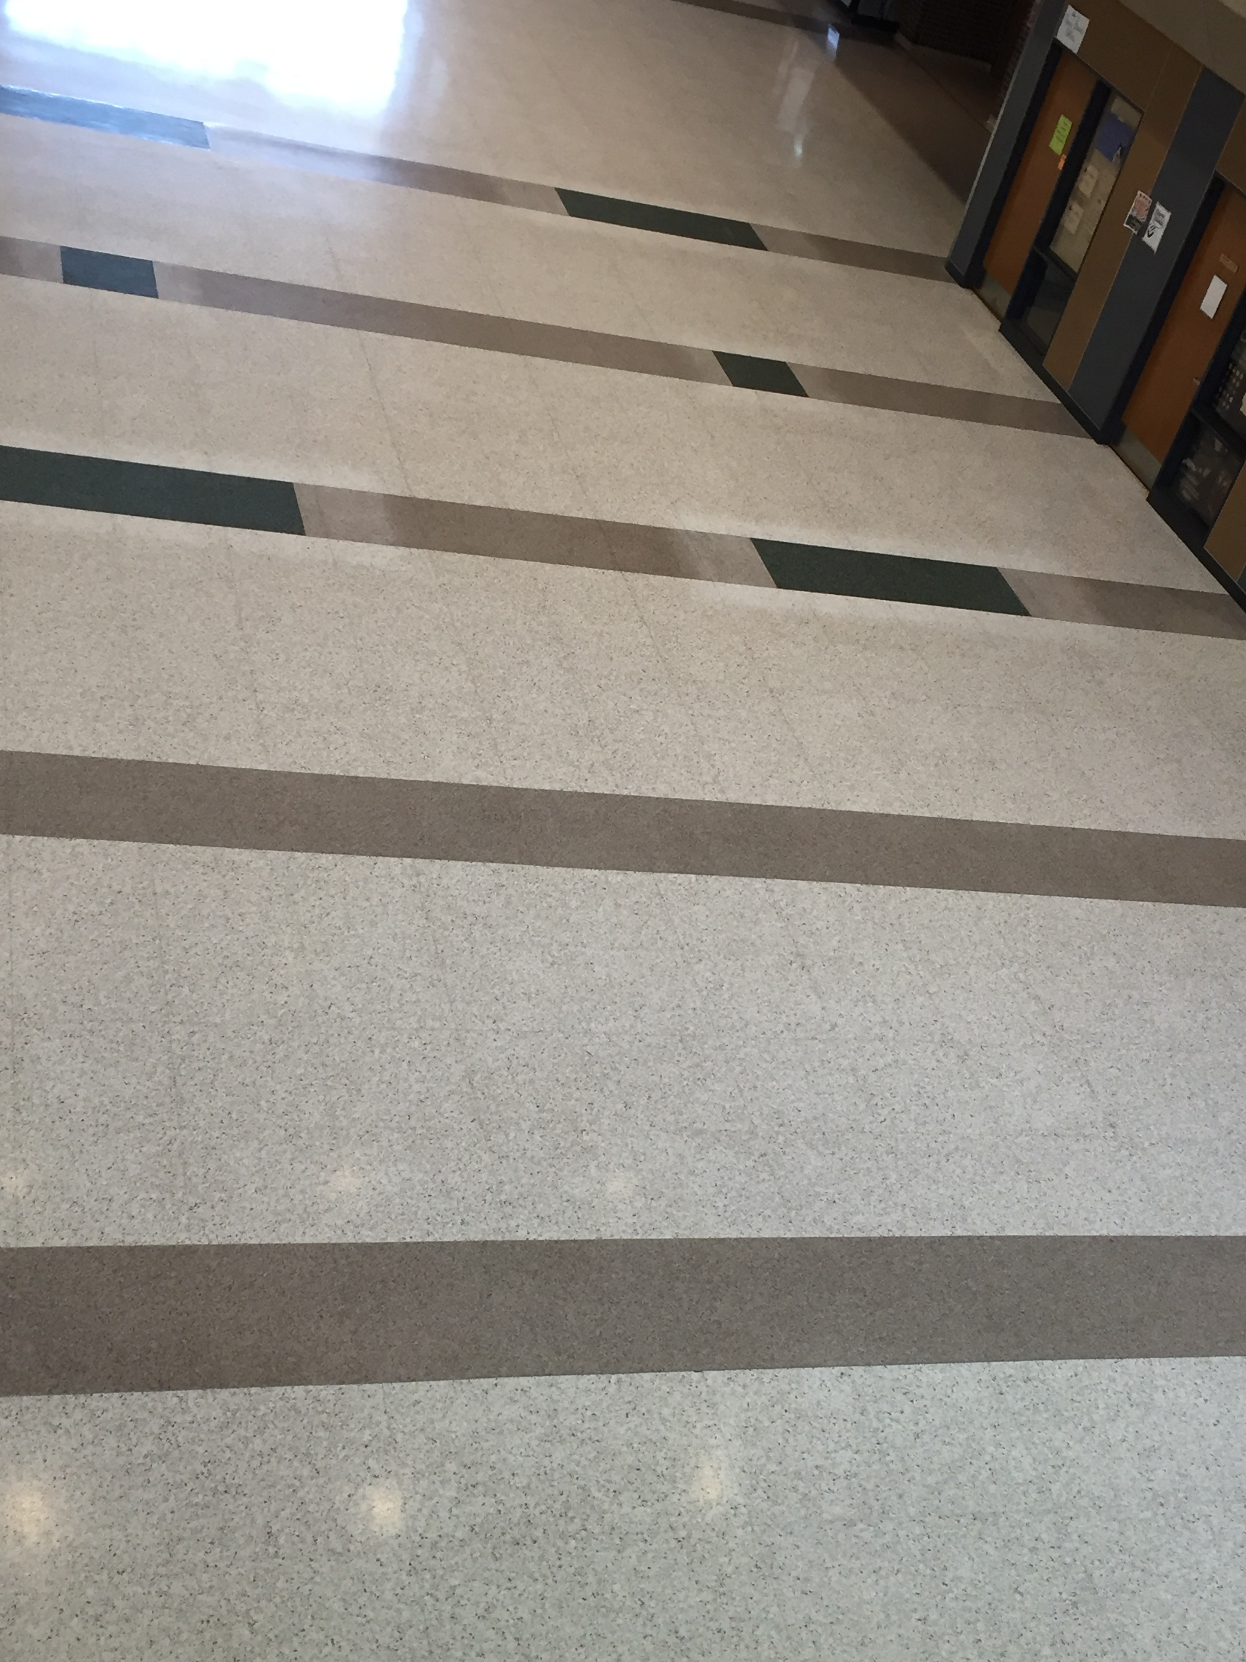
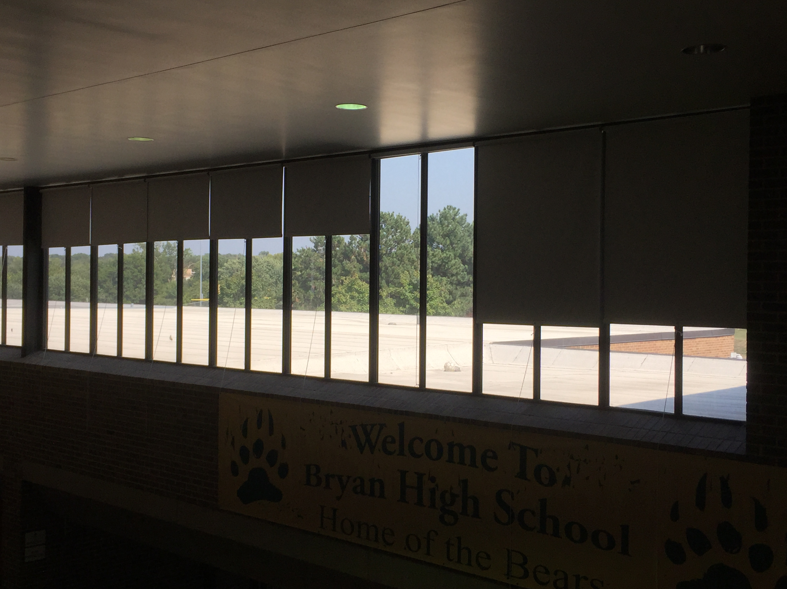
Where have you seen this pattern? (just pick 1 to code in The Grid)

Slide 12
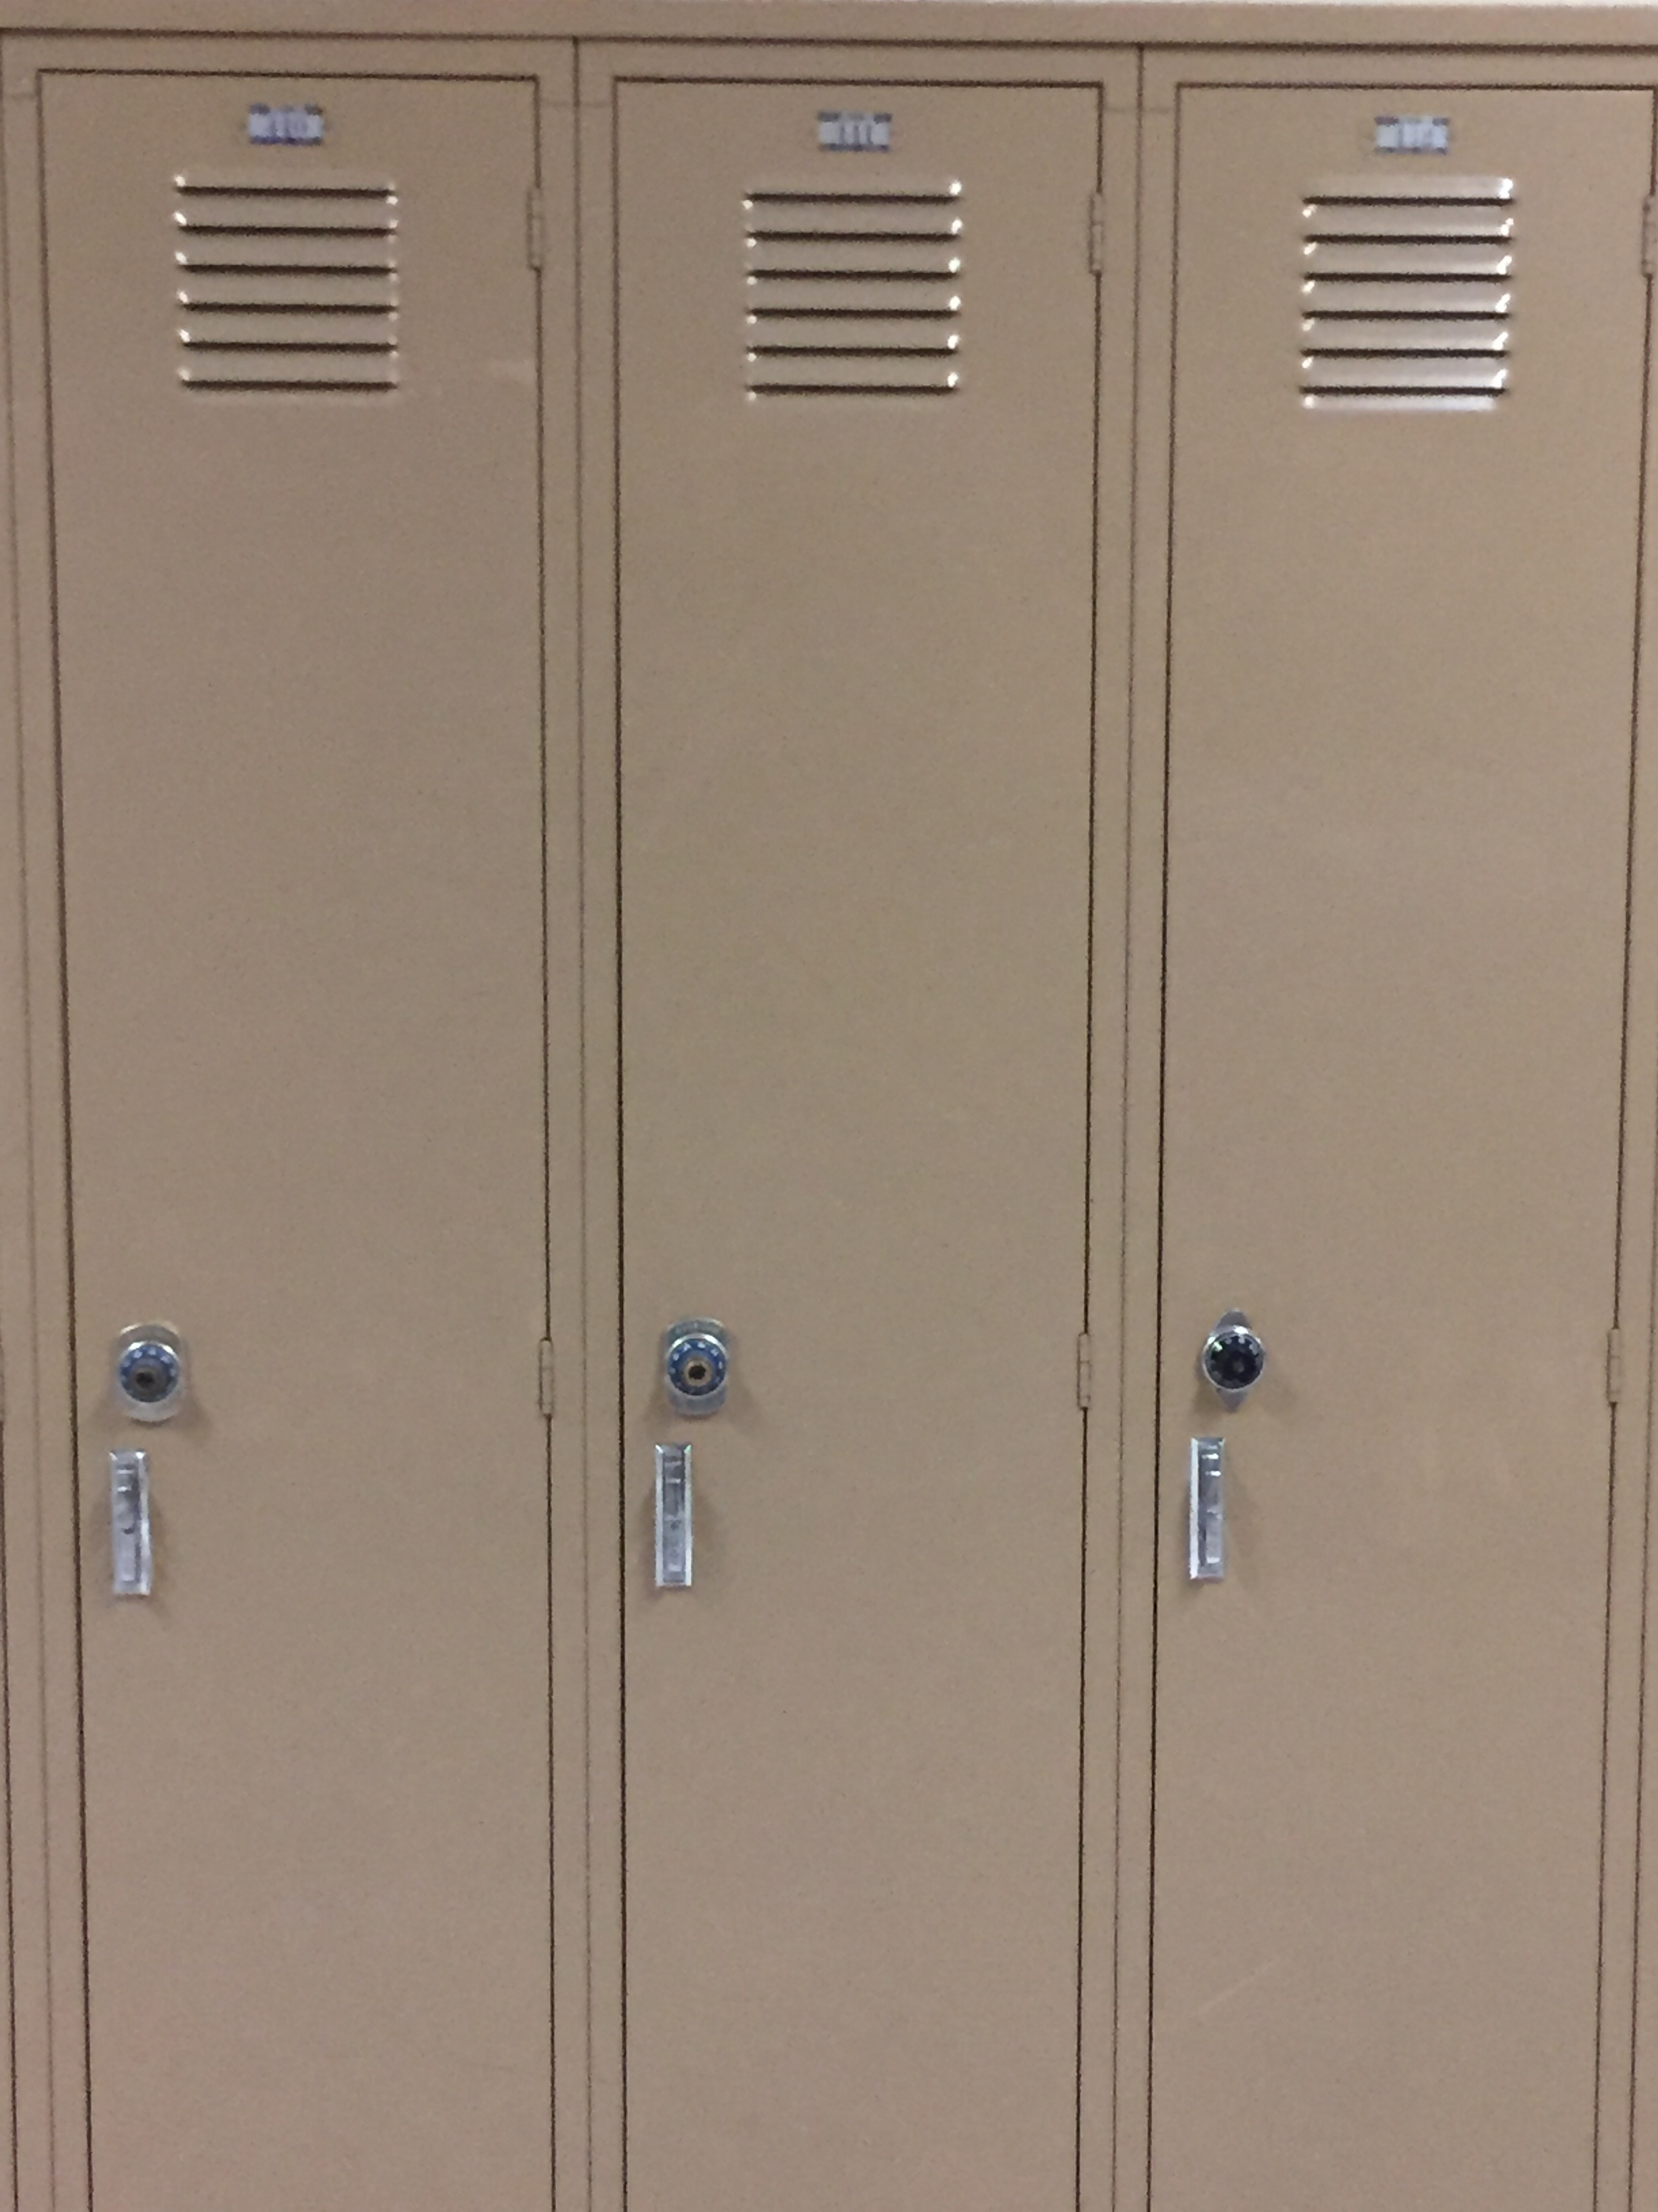
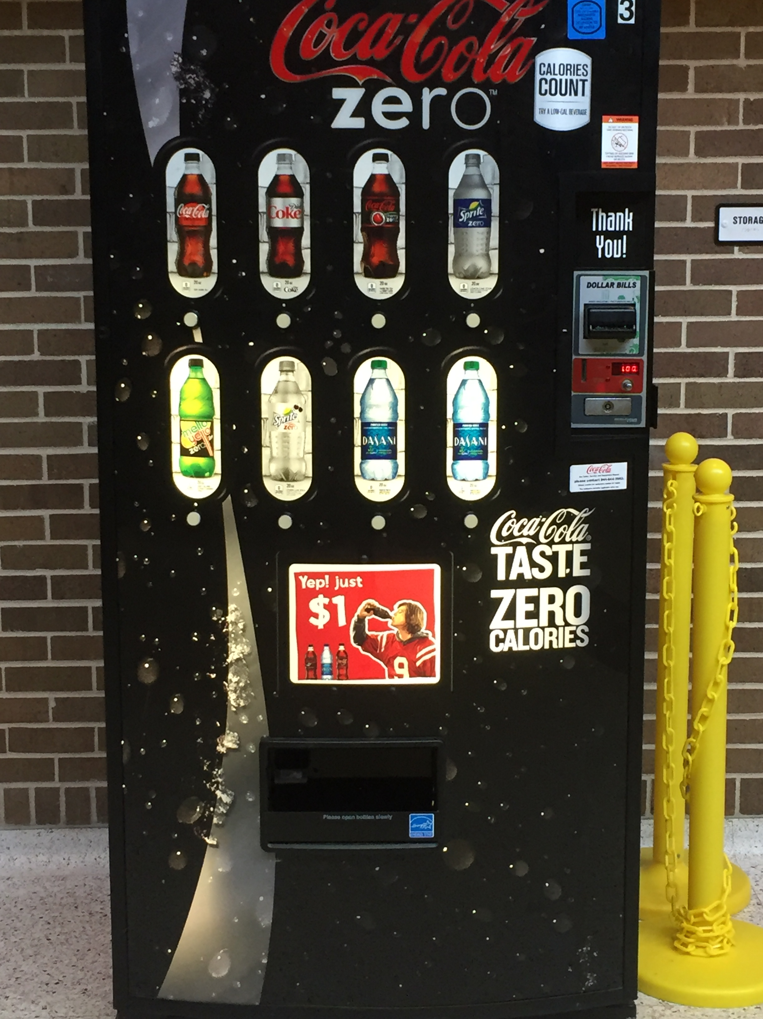
Challenge: Add enough detail to your code that someone would be able to identify either of the following images.

